Slide 1
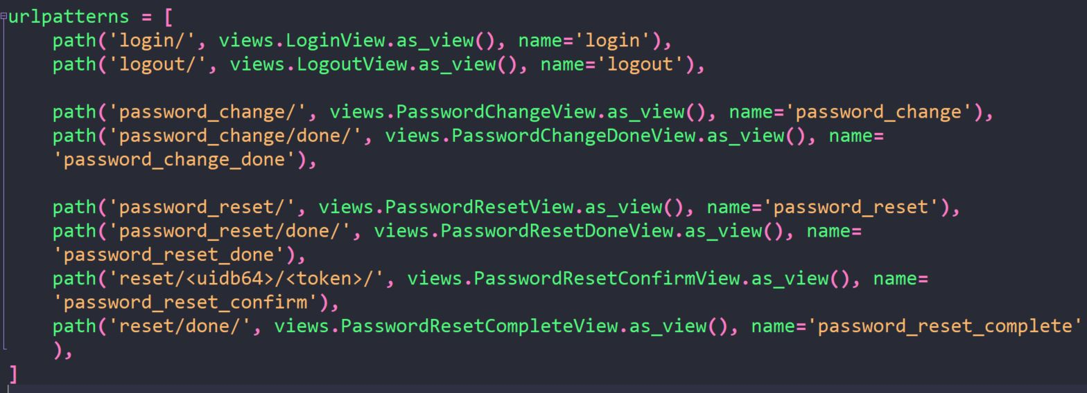
Authentication Views
Django provides several views that you can use for handling login, logout, and password management.
These make use of the stock auth forms but you can pass in your own forms as well.
Django provides no default template for the authentication views.
You should create your own templates for the views you want to use.
urls.py
path('accounts/', include('django.contrib.auth.urls’)),
These all url will be available:-
accounts/login/ [name='login']
accounts/logout/ [name='logout']
accounts/password_change/ [name='password_change']
accounts/password_change/done/ [name='password_change_done']
accounts/password_reset/ [name='password_reset']
accounts/password_reset/done/ [name='password_reset_done']
accounts/reset/<uidb64>/<token>/ [name='password_reset_confirm']
accounts/reset/done/ [name='password_reset_complete']

Slide 2
Authentication Views

Slide 3
login_required Decorator
login_required(redirect_field_name='next', login_url=None)
If the user is logged in, execute the view normally. The view code is free to assume the user is logged in.
If the user isn’t logged in, redirect to settings.LOGIN_URL, passing the current absolute path in the query string. Example: /accounts/login/?next=/accounts/profile/
django.contrib.auth.decorators.login_required
Where,
redirect_field_name - If you would prefer to use a different name for this parameter, login_required() takes an optional redirect_field_name parameter. If you provide a value to redirect_field_name, you will most likely need to customize your login template as well, since the template context variable which stores the redirect path will use the value of redirect_field_name as its key rather than "next" (the default).
login_url - If you don’t specify the login_url parameter, you’ll need to ensure that the settings.LOGIN_URL and your login view are properly associated.
The settings.LOGIN_URL also accepts view function names and named URL patterns. This allows you to freely remap your login view within your URLconf without having to update the setting.

Slide 4
login_required Decorator
Example:-
from django.contrib.auth.decorators import login_required
@login_required
def profile(request):
return render(request, 'registration/profile.html')

Slide 5
staff_member_required decorator
staff_member_required(redirect_field_name='next', login_url='admin:login’)
This decorator is used on the admin views that require authorization. A view decorated with this function will having the following behavior:
If the user is logged in, is a staff member (User.is_staff=True), and is active (User.is_active=True), execute the view normally.
Otherwise, the request will be redirected to the URL specified by the login_url parameter, with the originally requested path in a query string variable specified by redirect_field_name. For example: /admin/login/?next=/profile/
Example:-
from django.contrib.admin.views.decorators import staff_member_required
@staff_member_required
def profile(request):
return render(request, 'registration/profile.html')

Slide 6
permission_required Decorator
permission_required(perm, login_url=None, raise_exception=False)
It’s a relatively common task to check whether a user has a particular permission. For that reason, Django provides a shortcut for that case: the permission_required() decorator.
Just like the has_perm() method, permission names take the form “<app label>.<permission codename>”
Example:-
from django.contrib.auth.decorators import permission_required
@permission_required(‘blog.can_add’)
def profile(request):
return render(request, 'registration/profile.html')

Slide 7
Decorating Class-Based View
Decorating in urls.py or URLconf
The simplest way of decorating class-based views is to decorate the result of the as_view() method. The easiest place to do this is in the URLconf where you deploy your view:
from django.urls import path
from django.views.generic import TemplateView
from registration.views import ProfileTemplateView
from django.contrib.auth.decorators import login_required
urlpatterns = [
path(‘dashboard/', login_required(TemplateView.as_view(template_name=‘blog/dash.html')), name=‘dash’),
path('profile/', login_required(ProfileTemplateView.as_view(template_name='registration/profile.html')), name='profile’),
path(‘blogpost/', permission_required(‘blog.can_add’)(BlogPostView.as_view())),
]

Slide 8
method_decorator
The method_decorator decorator transforms a function decorator into a method decorator so that it can be used on an instance method.
A method on a class isn’t quite the same as a standalone function, so you can’t just apply a function decorator to the method you need to transform it into a method decorator first.
@method_decorator(*args, **kwargs)

Slide 9
Decorating Class-Based View
Decorating in the Class
To decorate every instance of a class-based view, you need to decorate the class definition itself. To do this you apply the decorator to the dispatch() method of the class.
from django.utils.decorators import method_decorator
from django.views.generic import TemplateView
class ProfileTemplateView(TemplateView):
template_name = ‘registration/profile.html'
@method_decorator(login_required)
def dispatch(self, *args, **kwargs):
return super().dispatch(*args, **kwargs)

Slide 10
Decorating Class-Based View
Decorating in the Class
You can decorate the class instead and pass the name of the method to be decorated as the keyword argument name:
@method_decorator(login_required, name='dispatch')
class ProfileTemplateView(TemplateView):
template_name = ‘registration/profile.html'

Slide 11
Decorating Class-Based View
Decorating in the Class
If you have a set of common decorators used in several places, you can define a list or tuple of decorators and use this instead of invoking method_decorator() multiple times.
@method_decorator(never_cache, name='dispatch')
@method_decorator(login_required, name='dispatch')
class ProfileTemplateView(TemplateView):
template_name = ‘registration/profile.html'
decorators = [never_cache, login_required]
@method_decorator(decorators, name='dispatch')
class ProfileTemplateView(TemplateView):
template_name = ‘registration/profile.html'
The decorators will process a request in the order they are passed to the decorator. In the example, never_cache() will process the request before login_required().

Slide 12
Authentication Views
This is a list with all the views django.contrib.auth provides.
LoginView
LogoutView
PasswordChangeView
PasswordChangeDoneView
PasswordResetView
PasswordResetDoneView
PasswordResetConfirmView
PasswordResetCompleteView

Slide 13
LoginView
django.contrib.auth.views.LoginView
template_name = 'registration/login.html’
path('login/', views.LoginView.as_view(), name='login’)
It’s your responsibility to provide the html for the login template , called registration/login.html by default.
If called via GET, it displays a login form that POSTs to the same URL.
If called via POST with user submitted credentials, it tries to log the user in.
If login is successful, the view redirects to the URL specified in next.
If next isn’t provided, it redirects to settings.LOGIN_REDIRECT_URL (which defaults to /accounts/profile/).
If login isn’t successful, it redisplays the login form.

Slide 14
LoginView
Default Template:-
registration/login.html
This template gets passed four template context variables:
form: A Form object representing the AuthenticationForm.
next: The URL to redirect to after successful login. This may contain a query string, too.
site: The current Site, according to the SITE_ID setting. If you don’t have the site framework installed, this will be set to an instance of RequestSite, which derives the site name and domain from the current HttpRequest.
site_name: An alias for site.name. If you don’t have the site framework installed, this will be set to the value of request.META['SERVER_NAME’].
Custom Template:-
path('login/', views.LoginView.as_view(template_name='myapp/login.html'), name='login’)

Slide 15
LoginView
Attributes:-
template_name: The name of a template to display for the view used to log the user in. Defaults to registration/login.html.
redirect_field_name: The name of a GET field containing the URL to redirect to after login. Defaults to next.
authentication_form: A callable (typically a form class) to use for authentication. Defaults to AuthenticationForm.
extra_context: A dictionary of context data that will be added to the default context data passed to the template.
redirect_authenticated_user: A boolean that controls whether or not authenticated users accessing the login page will be redirected as if they had just successfully logged in. Defaults to False.
success_url_allowed_hosts: A set of hosts, in addition to request.get_host(), that are safe for redirecting after login. Defaults to an empty set.

Slide 16
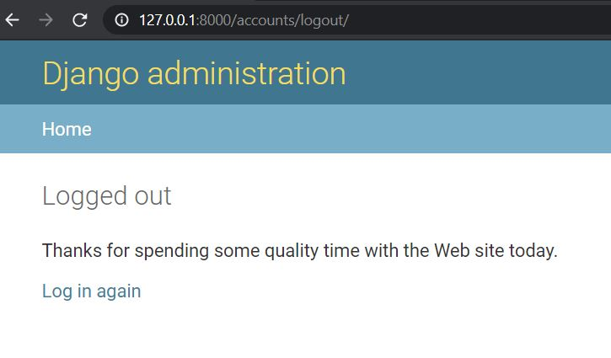
LogoutView
django.contrib.auth.views.LogoutView
template_name =‘registration/logged_out.html’
path('logout/', views.LogoutView.as_view(), name='logout’)
logged_out.html template is already available and used by admin logout template file.
You can create your own custom logout template by defining template_name attribute.

Slide 17
LogoutView
Default Template:-
registration/logged_out.html
This template gets passed three template context variables:
title: The string “Logged out”, localized.
site: The current Site, according to the SITE_ID setting. If you don’t have the site framework installed, this will be set to an instance of RequestSite, which derives the site name and domain from the current HttpRequest.
site_name: An alias for site.name. If you don’t have the site framework installed, this will be set to the value of request.META['SERVER_NAME’].
Custom Template:-
path('logout/', views.LogoutView.as_view(template_name=‘myapp/logout.html’), name='logout’)

Slide 18
LogoutView
Attributes:-
next_page: The URL to redirect to after logout. Defaults to settings.LOGOUT_REDIRECT_URL.
template_name: The full name of a template to display after logging the user out. Defaults to registration/logged_out.html.
redirect_field_name: The name of a GET field containing the URL to redirect to after log out. Defaults to next. Overrides the next_page URL if the given GET parameter is passed.
extra_context: A dictionary of context data that will be added to the default context data passed to the template.
success_url_allowed_hosts: A set of hosts, in addition to request.get_host(), that are safe for redirecting after logout. Defaults to an empty set.

Slide 19
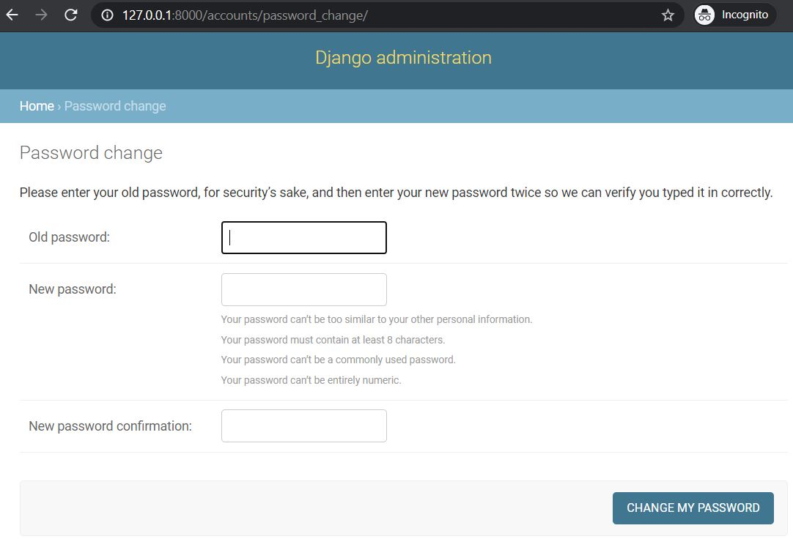
PasswordChangeView
django.contrib.auth.views.PasswordChangeView
template_name =‘registration/password_change_form.html’
path('password_change/', views.PasswordChangeView.as_view(), name='password_change’),
registration/password_change_form.html template is already available and used by admin change password template file.
You can create your own custom change password template by defining template_name attribute.

Slide 20
PasswordChangeView
Default Template:-
registration/password_change_form.html
This template gets passed following template context variables:
form: The password change form
Custom Template:-
path('password_change/', views.PasswordChangeView.as_view(template_name=‘myapp/changepass.html’), name='password_change'),

Slide 21
PasswordChangeView
Attributes:-
template_name: The full name of a template to use for displaying the password change form. Defaults to registration/password_change_form.html if not supplied.
success_url: The URL to redirect to after a successful password change. Defaults to 'password_change_done'.
form_class: A custom “change password” form which must accept a user keyword argument. The form is responsible for actually changing the user’s password. Defaults to PasswordChangeForm.
extra_context: A dictionary of context data that will be added to the default context data passed to the template.

Slide 22
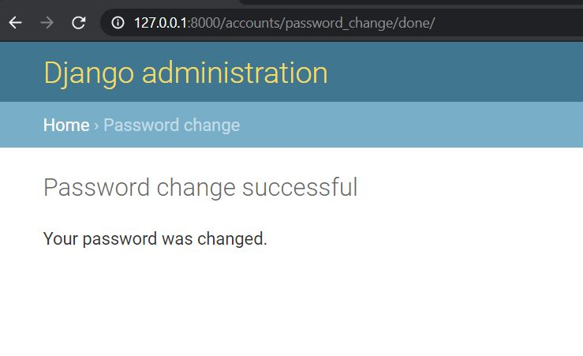
PasswordChangeDoneView
django.contrib.auth.views.PasswordChangeDoneView
template_name =‘registration/password_change_done.html’
path('password_change/done/', views.PasswordChangeDoneView.as_view(), name='password_change_done’),
registration/password_change_done.html template is already available and used by admin password change done template file.
You can create your own custom password change done template by defining template_name attribute.

Slide 23
PasswordChangeDoneView
Default Template:-
registration/password_change_done.html
Custom Template:-
path('password_change/done/', views.PasswordChangeDoneView.as_view(template_name=‘myapp/changepassdone.html’), name='password_change_done’),

Slide 24
PasswordChangeDoneView
Attributes:-
template_name: The full name of a template to use. Defaults to registration/password_change_done.html if not supplied.
extra_context: A dictionary of context data that will be added to the default context data passed to the template.

Slide 25
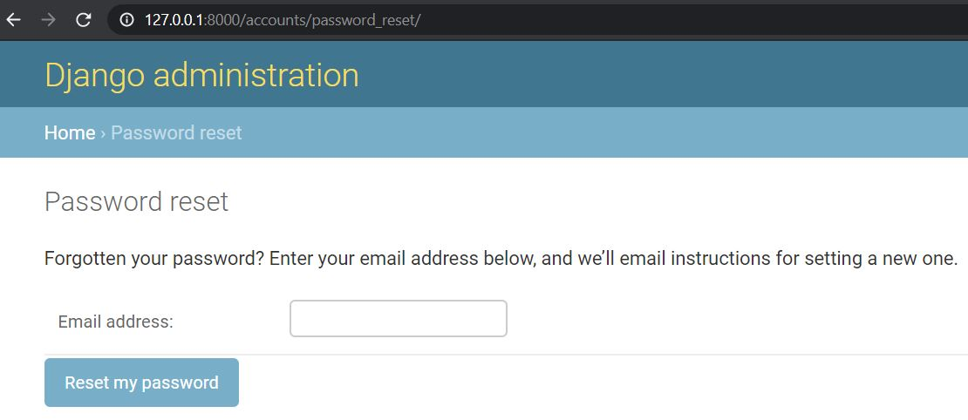
PasswordResetView
django.contrib.auth.views.PasswordResetView
template_name =‘registration/password_reset_form.html’
path('password_reset/', views.PasswordResetView.as_view(), name='password_reset’),
registration/password_reset_form.html template is already available and used by admin password reset template file.
You can create your own custom password reset template by defining template_name attribute.

Slide 26
PasswordResetView
Default Template:-
registration/password_reset_form.html
This template gets passed following template context variables:
form: The form for resetting the user’s password.
Custom Template:-
path('password_reset/', views.PasswordResetView.as_view(template_name=‘myapp/resetpass.html’), name='password_reset’),

Slide 27
PasswordResetView
This Email template gets passed following email template context variables:
email: An alias for user.email
user: The current User, according to the email form field. Only active users are able to reset their passwords (User.is_active is True).
site_name: An alias for site.name. If you don’t have the site framework installed, this will be set to the value of request.META['SERVER_NAME']. For more on sites, see The “sites” framework.
domain: An alias for site.domain. If you don’t have the site framework installed, this will be set to the value of request.get_host().
protocol: http or https
uid: The user’s primary key encoded in base 64.
token: Token to check that the reset link is valid.

Slide 28
PasswordResetView
Attributes:-
template_name: The full name of a template to use for displaying the password reset form. Defaults to registration/password_reset_form.html if not supplied.
form_class: Form that will be used to get the email of the user to reset the password for. Defaults to PasswordResetForm.
email_template_name: The full name of a template to use for generating the email with the reset password link. Defaults to registration/password_reset_email.html if not supplied.
subject_template_name: The full name of a template to use for the subject of the email with the reset password link. Defaults to registration/password_reset_subject.txt if not supplied.
token_generator: Instance of the class to check the one time link. This will default to default_token_generator, it’s an instance of django.contrib.auth.tokens.PasswordResetTokenGenerator.
success_url: The URL to redirect to after a successful password reset request. Defaults to 'password_reset_done'.

Slide 29
PasswordResetView
Attributes:-
from_email: A valid email address. By default Django uses the DEFAULT_FROM_EMAIL.
extra_context: A dictionary of context data that will be added to the default context data passed to the template.
html_email_template_name: The full name of a template to use for generating a text/html multipart email with the password reset link. By default, HTML email is not sent.
extra_email_context: A dictionary of context data that will be available in the email template. It can be used to override default template context values listed below e.g. domain.

Slide 30
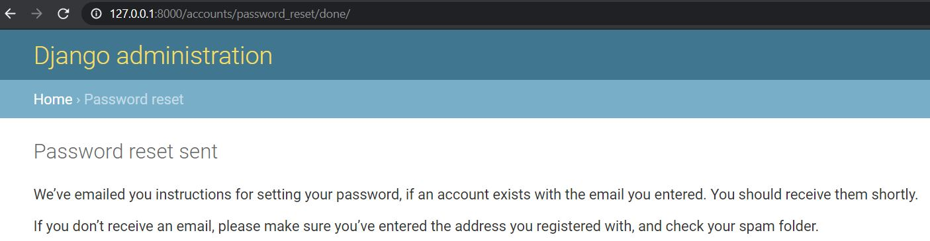
PasswordResetDoneView
django.contrib.auth.views.PasswordResetDoneView
The page shown after a user has been emailed a link to reset their password. This view is called by default if the PasswordResetView doesn’t have an explicit success_url URL set.
If the email address provided does not exist in the system, the user is inactive, or has an unusable password, the user will still be redirected to this view but no email will be sent.
template_name =‘registration/password_reset_done.html’
path('password_reset/done/', views.PasswordResetDoneView.as_view(), name='password_reset_done’),
registration/password_reset_done.html template is already available and used by admin password reset done template file.
You can create your own custom password reset done template by defining template_name attribute.

Slide 31
PasswordResetDoneView
Default Template:-
registration/password_reset_done.html
Custom Template:-
path('password_reset/done/', views.PasswordResetDoneView.as_view(template_name=‘myapp/resetpassdone.html’), name='password_reset_done’),

Slide 32
PasswordResetDoneView
Attributes:-
template_name: The full name of a template to use. Defaults to registration/password_reset_done.html if not supplied.
extra_context: A dictionary of context data that will be added to the default context data passed to the template.

Slide 33
PasswordResetConfirmView
django.contrib.auth.views.PasswordResetConfirmView
It presents a form for entering a new password.
Keyword arguments from the URL:
uidb64: The user’s id encoded in base 64.
token: Token to check that the password is valid.
template_name =‘registration/password_reset_confirm.html’
path('reset/<uidb64>/<token>/', views.PasswordResetConfirmView.as_view(), name='password_reset_confirm’),
registration/password_reset_confirm.html template is already available and used by admin password reset confirm template file.
You can create your own custom password reset confirm template by defining template_name attribute.

Slide 34
PasswordResetConfirmView
Default Template:-
registration/password_reset_confirm.html
This template gets passed following template context variables:
form: The form for setting the new user’s password.
validlink: Boolean, True if the link (combination of uidb64 and token) is valid or unused yet.
Custom Template:-
path('reset/<uidb64>/<token>/', views.PasswordResetConfirmView.as_view(template_name=‘myapp/resetpassconfirm.html’), name='password_reset_confirm'),

Slide 35
PasswordResetConfirmView
Attributes:-
template_name: The full name of a template to display the confirm password view. Default value is registration/password_reset_confirm.html.
token_generator: Instance of the class to check the password. This will default to default_token_generator, it’s an instance of django.contrib.auth.tokens.PasswordResetTokenGenerator.
post_reset_login: A boolean indicating if the user should be automatically authenticated after a successful password reset. Defaults to False.
post_reset_login_backend: A dotted path to the authentication backend to use when authenticating a user if post_reset_login is True. Required only if you have multiple AUTHENTICATION_BACKENDS configured. Defaults to None.
form_class: Form that will be used to set the password. Defaults to SetPasswordForm.
success_url: URL to redirect after the password reset done. Defaults to 'password_reset_complete’.
extra_context: A dictionary of context data that will be added to the default context data passed to the template.

Slide 36
PasswordResetConfirmView
Attributes:-
reset_url_token: Token parameter displayed as a component of password reset URLs. Defaults to 'set-password'.

Slide 37
PasswordResetCompleteView
django.contrib.auth.views.PasswordResetCompleteView
It presents a view which informs the user that the password has been successfully changed.
template_name =‘registration/password_reset_complete.html’
path('reset/done/', views.PasswordResetCompleteView.as_view(), name='password_reset_complete’),
registration/password_reset_complete.html template is already available and used as admin password reset complete template file.
You can create your own custom password reset complete template by defining template_name attribute.

Slide 38
PasswordResetCompleteView
Default Template:-
registration/password_reset_complete.html
Custom Template:-
path('reset/done/', views.PasswordResetCompleteView.as_view(template_name=‘myapp/resetpasscomp.html’), name='password_reset_complete'),

Slide 39
PasswordResetCompleteView
Attributes:-
template_name: The full name of a template to display the view. Defaults to registration/password_reset_complete.html.
extra_context: A dictionary of context data that will be added to the default context data passed to the template.

Slide 40
Built-in Forms
AdminPasswordChangeForm - A form used in the admin interface to change a user’s password. It takes the user as the first positional argument.
AuthenticationForm - A form for logging a user in. It takes request as its first positional argument, which is stored on the form instance for use by sub-classes.
PasswordChangeForm - A form for allowing a user to change their password.
PasswordResetForm - A form for generating and emailing a one-time use link to reset a user’s password.
SetPasswordForm - A form that lets a user change their password without entering the old password.
UserChangeForm - A form used in the admin interface to change a user’s information and permissions.
UserCreationForm - A ModelForm for creating a new user.

